Slide 1

// own your data. own your skills.
From Convenience to Control
Breaking Free from Big Tech Data Platforms
Enrico van de Laar

Slide 2
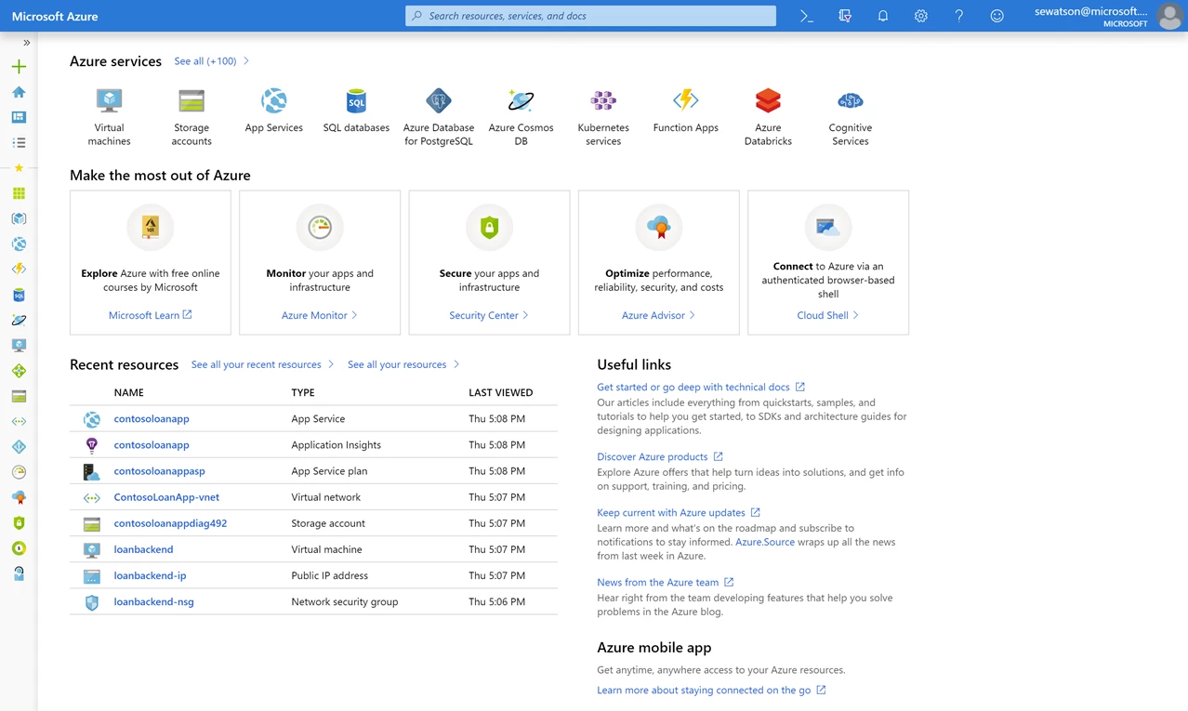
// 1. the illusion of control
Notes:
Anyone knows what this screenshot shows?
Who owns the resources you are looking at?
We will get back to this…

Slide 3




// who's talking
I make complex data & AI easy to understand.
+
25+ years working with data
+
Former Microsoft Data Platform MVP
Enrico van de Laar
+
Author of four books
data · author · trainer
+
Co-founder Privinity & putSimply
enricovandelaar.com
linkedin.com/in/enricovdlaar
github.com/evdlaar
Notes:
Short intro, quick move towards the agenda on next slide
More on putSimply at the end of the presentation

Slide 4
// what we'll cover
1
The illusion of control – why “your data” isn’t your data
2
How did we get here – infrastructure abstractions, government power and legislation
3
What sovereignty really means – and what it doesn’t
4
Building a sovereign data platform – principles and reference architecture
5
The uncomfortable truth – what this is costing you
6
Where to start this Monday

Slide 5

// 1. the illusion of control
A regular Tuesday morning for the data team
Everything you rely on before lunch
Log In Entra ID
Standup Slack
Mail Exchange Online
Ingest Data Factory
Data storage OneLake
Transform Databricks
Dashboards PowerBI
Version Control GitHub
Deploy Azure DevOps
Ask the assistant OpenAI
Alerting Azure Monitor
Coffee Kitchen
Notes:
Here’s a selection of activities as well as the solutions they depend on
What’s left if we take out the activities that rely on US services and fall under US law? -> Click animation
Even though it seems we have control of these activities, we’ve focus on the value they deliver and let the hyperscalers provide the plumbing underneath

Slide 6
// 1. the illusion of control
?
Who can run their data pipelines this Monday if their hyperscaler account is blocked?
Notes:
Audience poll
Count hands (probably awfully few people)

Slide 7
// 2. how did we get here
We slowly gave up control
Running a datacenter yourself is hard
More abstractions lead to serverless
Integration connects everything seamlessly
Hyperscalers abstracted away the hardware layer leading to less worries for the IT department.
Virtual machines with database instances converted to SaaS based databases.
Identity management, networking, permissions connects all the services and glues them together.
Notes:
The integration between services like identity management made it far more difficult to extract a single service and run it somewhere else
With time the required skills needed also moved to the integrated platforms. When your team is trained in Fabric switching to another service is costly and might require new hires or even a strategic change
Once you are in and integrated, it becomes harder and harder to migrate away meaning hyperscalers can change their pricing and there is nothing you can do

Slide 8
// 2. how did we get here
Three things you cannot control
CLOUD Act
Government interference
No negotiations, but announcements
Any US company can be compelled to hand over data it controls, wherever that data physically sits.
The US government can require US companies to execute executive orders.
Moving away from hyperscalers is difficult and they know this. Meaning price increases become announcements instead of negotiations.
Notes:
The bolded part of the CLOUD act is the important bit: even if you store your data in an EU region, if the company is US-based they have to turn over your data if requested by the US government. This is a fact which Microsoft France’s Anton Carniaux under oath declared he cannot guarantee EU citizen data not being handed to the US authorities (though he mentioned it never happened)
In 2025, the ICC's Chief Prosecutor lost access to his Microsoft-hosted email while under US sanctions. Who made that call is disputed — Microsoft says the ICC did. What isn't disputed is what happened next: the ICC moved to OpenDesk, an open-source suite.

Slide 9
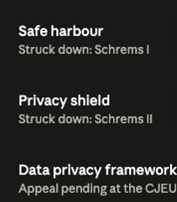
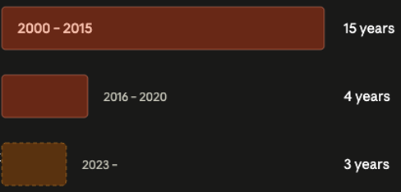
// 2. how did we get here
Europe did try to get back control
Notes:
We all know the joke “America innovates, China replicates and the EU regulates”
Seeing the amount of control of data, services and organizations moving away to US hyperscalers the EU tried to implement regulations so EU citizen data was protected from US laws
However these are under constant pressure and each new attempt is shot down faster
So if the paperwork can't fix this, what actually can? That depends on what we mean by sovereignty, and almost everyone means something different.

Slide 10
// 3. what sovereignty really means
Sovereignty is about control, not location
Sovereignty is the supreme, absolute, and uncontrollable power by which an independent state is governed, possessing exclusive authority to make laws, manage internal affairs, and rule a territory without any outside interference.
Encyclopedia Britannica
Notes:
The quote above is the political definition. No organisation will ever have that, and I'm not going to pretend otherwise. But strip out the absolutism and there's a usable core underneath
Now if we want to take back sovereignty on our data platform based on a organisational level we have to ask ourselves three questions:
Who can access our data?
Who can switch off our data platform?
Who sets the terms of our data platform?
This means that sovereignty doesn’t just mean “move your data platform from a US hyperscaler to an EU one” since the EU based hyperscaler could still have an influence on the questions above
Instead it means we – as an organisation – have to take back control on data access, data platform control and on our own terms.

Slide 11
// 3. what sovereignty really means
Four layers of sovereign data platform control
Data Who can read or access it?
Operations Who can switch it off?
Technology Could you rebuild it somewhere else?
Supply chain Who makes the parts it runs on?
Notes:
Most organisations think about the first layer and implement encryption, policies, autorisation, etc to protect it, but do nothing about the layers underneath it
Remember: turning off access to your platform – just like the ICC mailbox – requires different protection measures than your data

Slide 12

// 3. what sovereignty really means
Sovereignty is a dial, not a switch
Most of us here
0
1
2
3
4
No sovereignty
EU data location
EU operations
EU control plane
EU supply chain
Notes:
The European Commission's cloud sovereignty framework grades vendors on eight objectives and assurance levels running from SEAL-0, a complete lack of sovereignty, to SEAL-4, which requires a full EU supply chain from chips to software.
Levels:
1 = Data stored in EU
2 = Only EU personal can approve access to data, board of directors made of Europeans to oversee EU data centers (Microsoft Sovereign Cloud), owner is still US
3 = National partner cloud with a European legal entity
4 = Supply change independence. For instance on level 3 Microsoft tech can be operated by a EU partner cloud but if Microsoft changes the license you will still be affected
In terms of the four layers: Microsoft solves the who can access (tier 2), who can switch it off (tier 3) but can never solve who sets the terms since the software needs to be licensed from Microsoft
They only thing that realistic can achieve level four is a European open-source data platform that removes the license dependance, but to truly reach SEAL-4 in that case also the hardware should be EU build as well. Nobody is in SEAL-4 yet

Slide 13
// 3. what sovereignty really means
Different workloads, different level of sovereignty
Non-sensitive analytics
Safety critical systems
Public facing content
Internal operational data
(Privacy) sensitive data
Critical national infrastructure
0
1
2
3
4
No sovereignty
EU data location
EU operations
EU control plane
EU supply chain
Notes:
Not all your data or workloads demand the same level of sovereignty
Ask yourself: what happens if this is read, switched off, or repriced?
if you're at level 1 for the right workload, that's a correct answer, the problem often is nobody chooses

Slide 14
// 4. building a sovereign data platform
To build a sovereign data platform we need principles
Principle
The test
Data lives in open formats
Can I read the data with something I didn’t buy?
Storage and compute is replaceable
Can I easily swap storage or compute engines?
Identity stays ours
Can we still login when someone turns off our platform?
Migrate easily
Can we migrate our data platform (or specific services) or are we stuck?
Notes:
These are just some principles you have to account for. There are more you can define but I think you get the idea here

Slide 15
// 4. building a sovereign data platform
Open source ≠ sovereign
Open source is not automatically sovereign. Licenses can be changed.
Notes:
Notice I didn’t say anything in the principles about it having to be open source?
Open source licenses can change. For instance Terraform, Redis and Elastic have all changed their licenses.
The key check here is to validate who can change the license, and what happens to us if they do
A foundation-governed project with multiple independent contributors behaves differently from a single-vendor project where contributors sign over their rights.

Slide 16
// 4. building a sovereign data platform
A reference architecture
Consumption Apache Superset, Evidence
Compute Trino, DuckDB
Orchestration Apache Airflow
Processing dlt, dbt-core or SQLMesh
*
Catalog Apache Polaris, Iceberg REST API
Table format Apache Iceberg on Parquet
Identity Keycloak
Object storage SeaweedFS, Garage
Infrastructure EU provider or on-premises, Kubernetes or Docker
Notes:
Explain bottom up, click starts animation
Keep in mind that the infrastructure based on level 4 (EU silicon) is not possible
In this reference architecture I’ve focused on picking (mostly) open source solutions that are not tied to a single owner that can easily change the license.
It is aimed to be an alternative to Microsoft Fabric
Notice the lack of control pane: The control pane is the lock-in mechanism and the best feature of Fabric at the same time Not having this integration is one of the big challenges of having a sovereign, open source, data platform and we will get back on it later
Why no MinIO for Object Storage? The company abandoned the free open source community edition into maintenance mode in 2025 and archived the repository in February 2026. This proves the risk around vendor lead open source projects
This is also where the * is. dlt, dbt-core, and SQLMesh are all single-vendor projects but the Python and SQL that perform the transformations are owned by you

Slide 17
// demo
Consumption (Dashboard) Apache Superset
Compute (Query Engine) Trino & DuckDB
A self-hosted, open-source lakehouse
Processing (ETL) dlt & dbt-core
Catalog Apache Polaris, Iceberg REST API
Table format Apache Iceberg on Parquet
Object storage SeaweedFS
Infrastructure Docker
Notes:
The key part I want to show in this demo is how our principles on open formats and easy interchangeable services can be implemented
The stack shown is the one I choose to build this demo

Slide 18
// 5. the uncomfortable truth
Awesome! We now own the control plane!
Consumption Apache Superset, Evidence
Compute Trino, DuckDB
Orchestration Apache Airflow
Processing dlt, dbt-core or SQLMesh
Catalog Apache Polaris, Iceberg REST API
Table format Apache Iceberg on Parquet
Identity Keycloak
Object storage SeaweedFS, Ceph
Infrastructure EU provider or on-premises, Kubernetes or Docker
Your own control plane
Notes:
Fabrics control plane is free and integrated into the solution
Your control plane is all your and you have to take care of it
This means this (and more is all your responsibility now):
upgrades across seven components with their own release cycles
compatibility between them
monitoring
backups
disaster recovery

Slide 19
// 5. the uncomfortable truth
What you are now getting for free…
24/7 security operations
Automated patching
DDoS absorption
Elastic capacity
Widely available skilled personnel
Compliance certifications
Notes:
These things are part of the hyperscalers licenses really well
You should be prepared to abandon this when you leave Fabric for instance

Slide 20
// 5. the uncomfortable truth
And ultimately the bill arrives in people
Building a sovereign, open source, data platform is an HR project disguised as a technology challenge
Notes:
If you treat this as a migration between – for instance Fabric – and your own platform it will fail
The impact on people is huge:
The work shifts from configuring a platform to operating one, which is a different skill and often a different person.
Your team's market value is currently denominated in a specific vendor's certifications, so this is a career conversation, not just a technical one.
The hiring pool for the open stack is smaller, so you're competing for scarcer people.

Slide 21
// 5. the uncomfortable truth
A change in expenses
Hyperscaler
Self-hosted
Licenses and usage
Licenses and usage
People
People
Infrastructure
Infrastructure
Notes:
A self-hosted data platform is not obviously cheaper. At small scale it's usually more expensive, because you're paying salaries instead of amortising someone else's. At large scale it can flip.

Slide 22
// 5. the uncomfortable truth
You are not buying a cheaper platform. You are buying the ability to get and stay in control
Notes:
Punchline

Slide 23
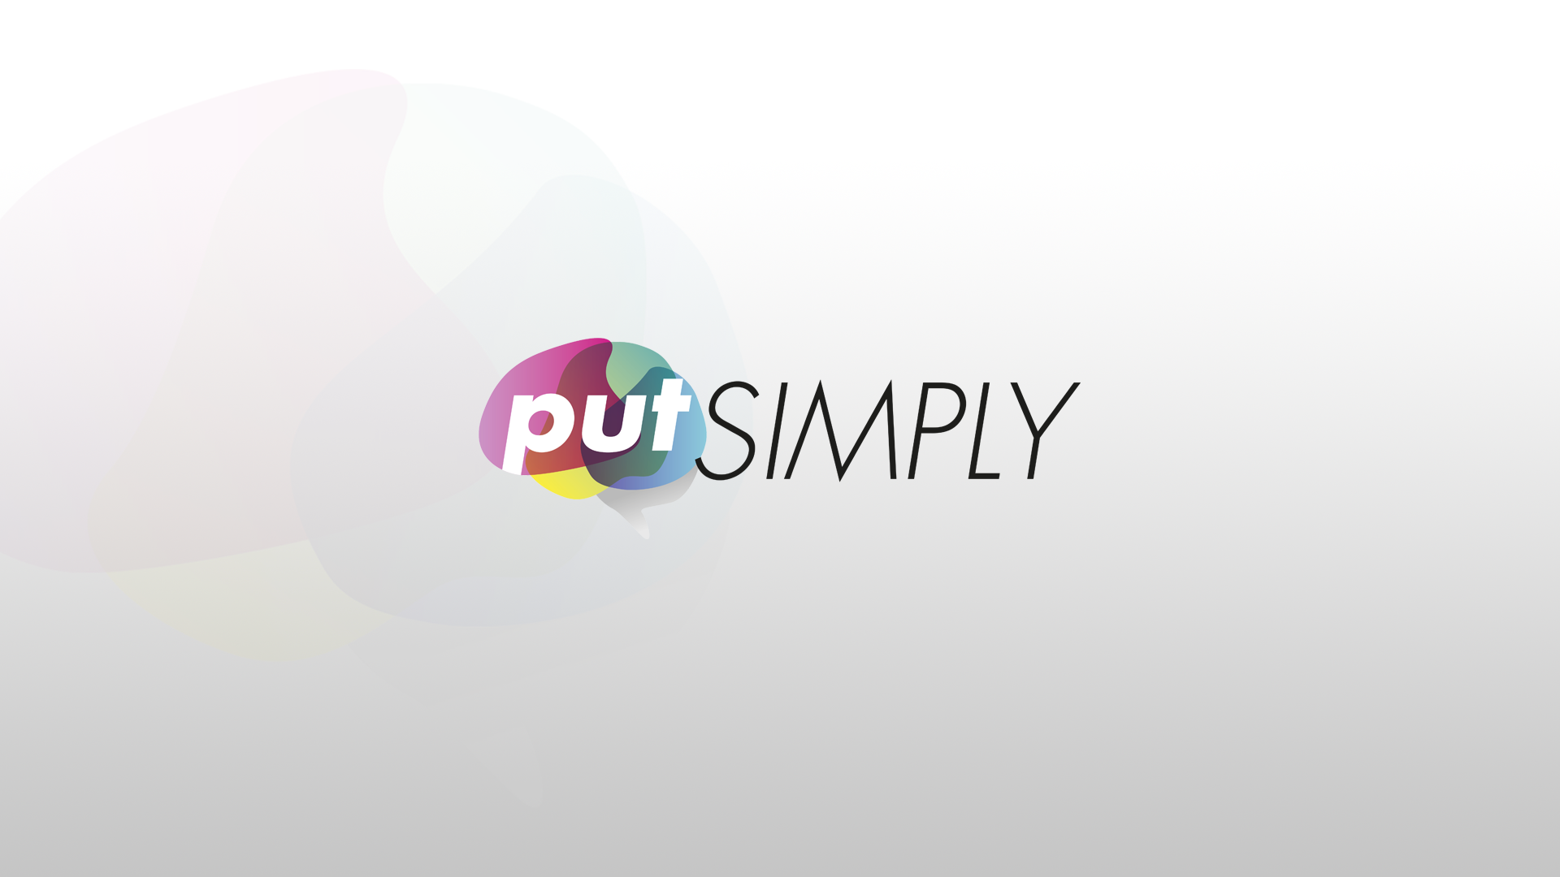
// 5. the uncomfortable truth
The choice we made at putSimply
Notes:
Explain what we do at putSimply
Since we expect to process texts that contain highly sensitive data we decided to put our backend infrastructure at an EU provider and using EU/open source AI models
However, we still use O365 for our internal environment

Slide 24
// 6. where to start this Monday
Get started with your own sovereign data platform
1
Find out where you currently stand on each layer of control
2
Stop making it worse. Develop using open formats for anything new
3
Find out what actually happens when your hyperscaler account is blocked
Notes:
Not a migration but an inventory. Take your four layers from The four control layers slide (11) and score them honestly for one critical pipeline: who can read it, who can switch it off, who sets the terms, and what it runs on This is a free step that only takes time
For anything new you build, write open formats and register it in a catalog you control. Parquet and Iceberg cost you nothing today and mean the next platform decision is a choice rather than a rescue.
And to come back on the question I asked at the start: This is how you find out
The only thing I'm actually asking is that you know where you stand. What you do with that is yours
Also keep in mind that many open source solutions that I’ve described can run fine in Azure as well, making a future migration even easier.

Slide 25

// own your data. own your skills.
Get the deck, the blueprint
& the updates.
enricovandelaar.com/sovereign
Enrico van de Laar

